Slide 1


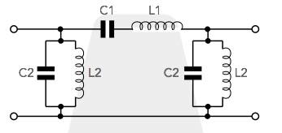
ECE6017 RF and Microwave Circuit Design
J COMPONENT
Second Review
Design of Highly Selective X- Band bandpass filter using Microstrip Coupled Line
Team Members Name
Pragadeshwar Vishnu 20MCE0010
Krishvadana S 20MCE0014

Slide 2
Contents
Objective
Design procedure
Simulation parameters
Simulation Results
Summary
Reference

Slide 3
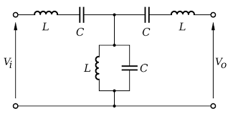
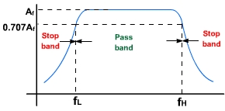
Objective
To design and analyse the BandPass Filter for X-band Applications with cascaded coupled line sections using microstrip line implementation.

Slide 4
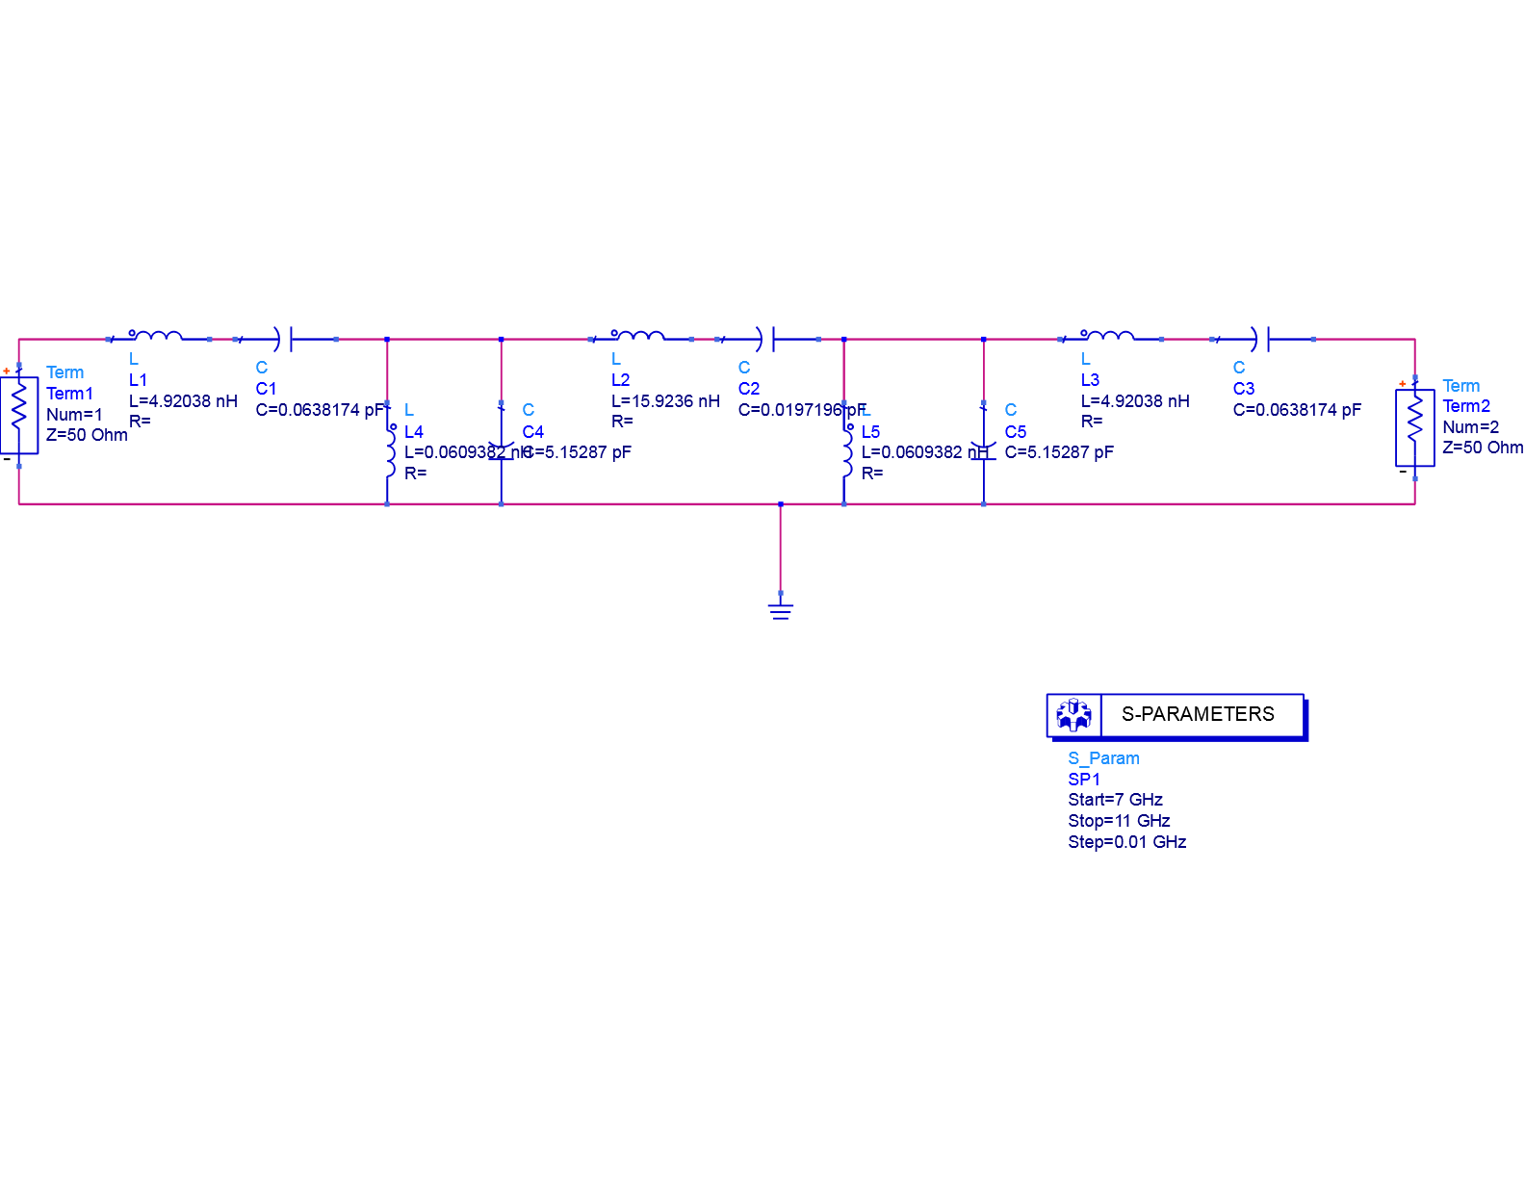
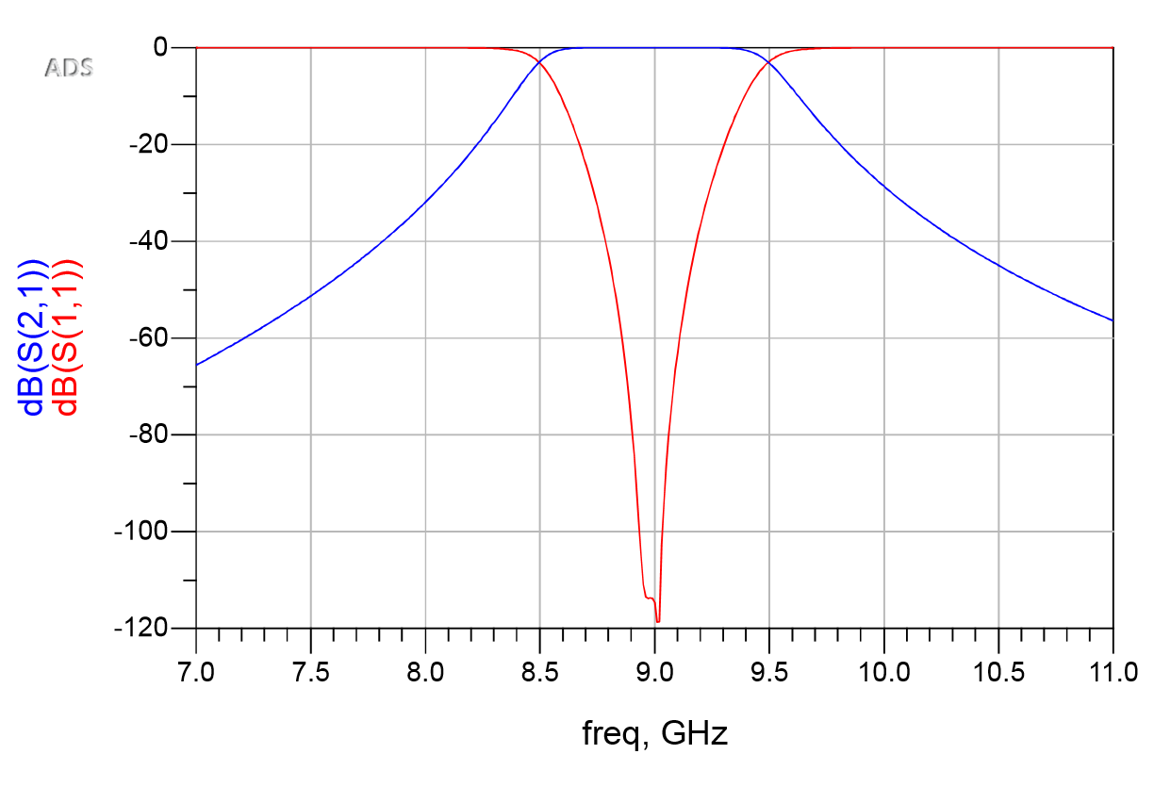
Lumped Element Circuit

Slide 5
Design Procedure
Determine the order of the system.
Prototype values of desired filter(ex: Butterworth, Bessel) are taken according the order. In Table 1 Maximally flat Filter(Butterworth) values are given.
Admittance inverter values are found out from the Eq.1 ->Eq.3
The Admittance values are converted to Odd and Even value impedance with Eq.4 and Eq.5
Using LincCalc tool Width, length and Spacing ratio is found out from odd and even impedance values for the coupled line sections.

Slide 6
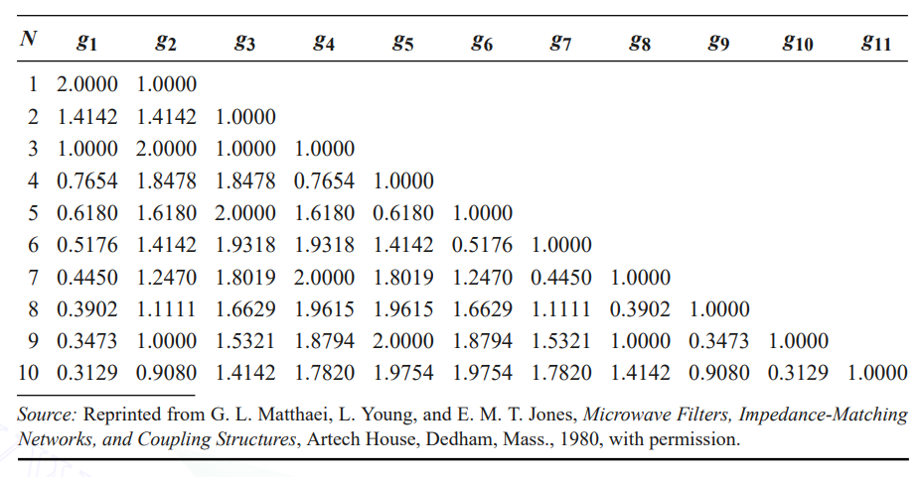
Table 1 Element values for Maximally flat Filter

Slide 7
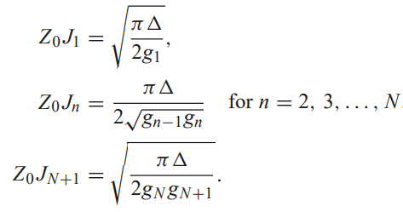
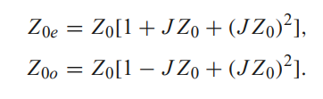
The design equations for a bandpass filter with N + 1 coupled line sections are:
Even- and odd-mode line impedances are calculated using:

Slide 8
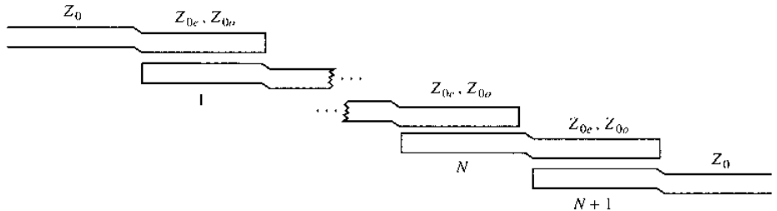
Design layout
Layout of an (N + 1)-section coupled line bandpass filter

Slide 9
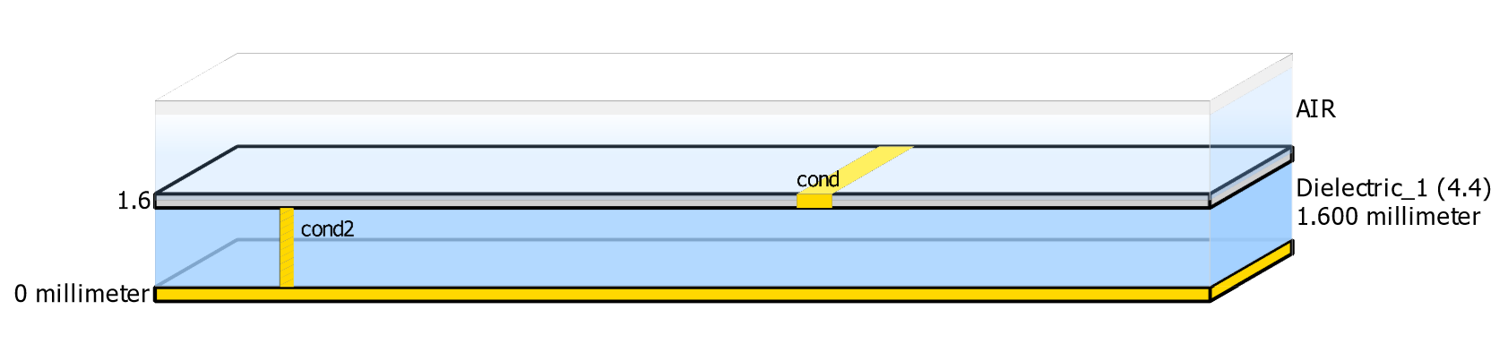
Substrate Design Parameters
Dielectric constant Er=4.4
Relative permeability Mur=1.0
Substrate thickness H=1.6 mm
Upper ground plane to substrate spacing Hu=3.9e+34 mm
Metal thickness T=0.036 mm
Conductivity Cond=4.1e7
Dielectric loss tangent TanD=0.001
Dielectric Loss Model=1

Slide 10
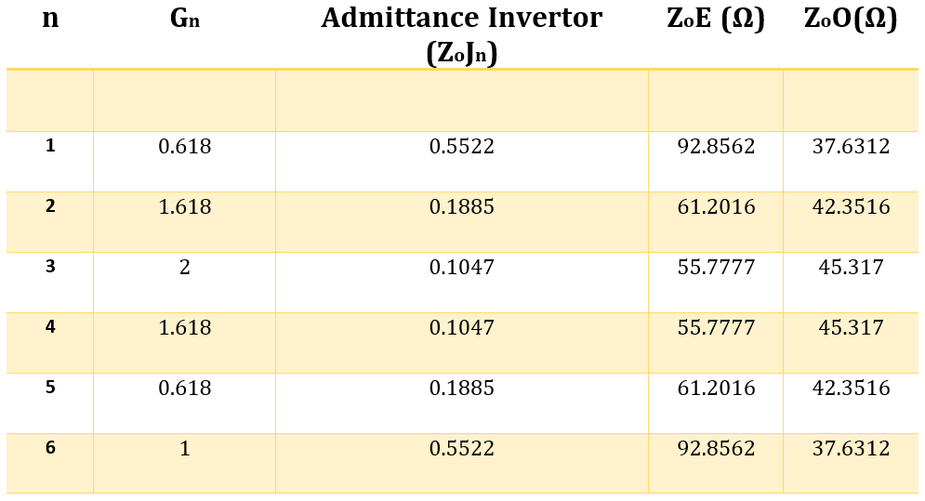
Design Values

Slide 11
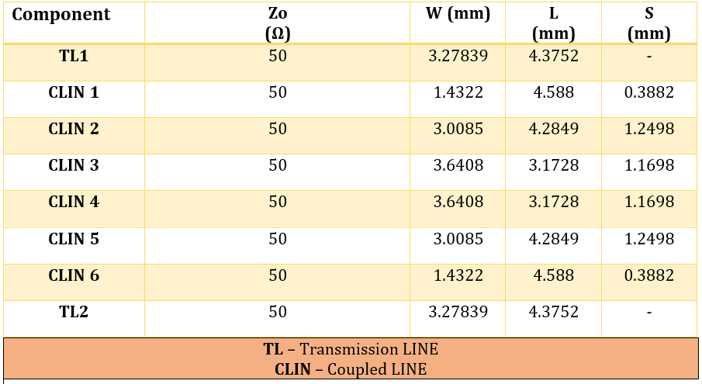
Dimensions for Distributed Elements

Slide 12
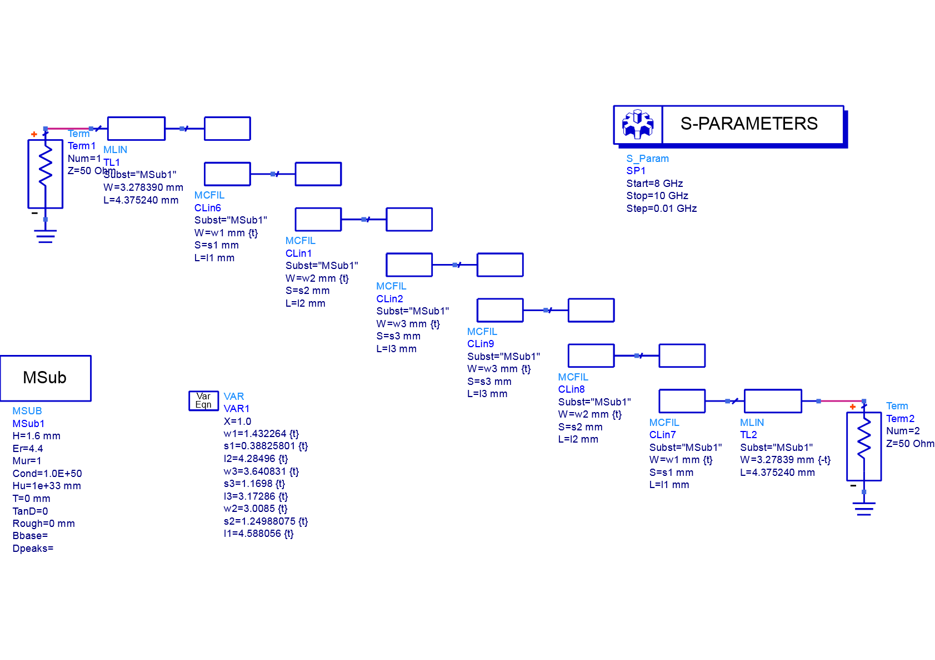
Schematic of Coupled Line Element

Slide 13
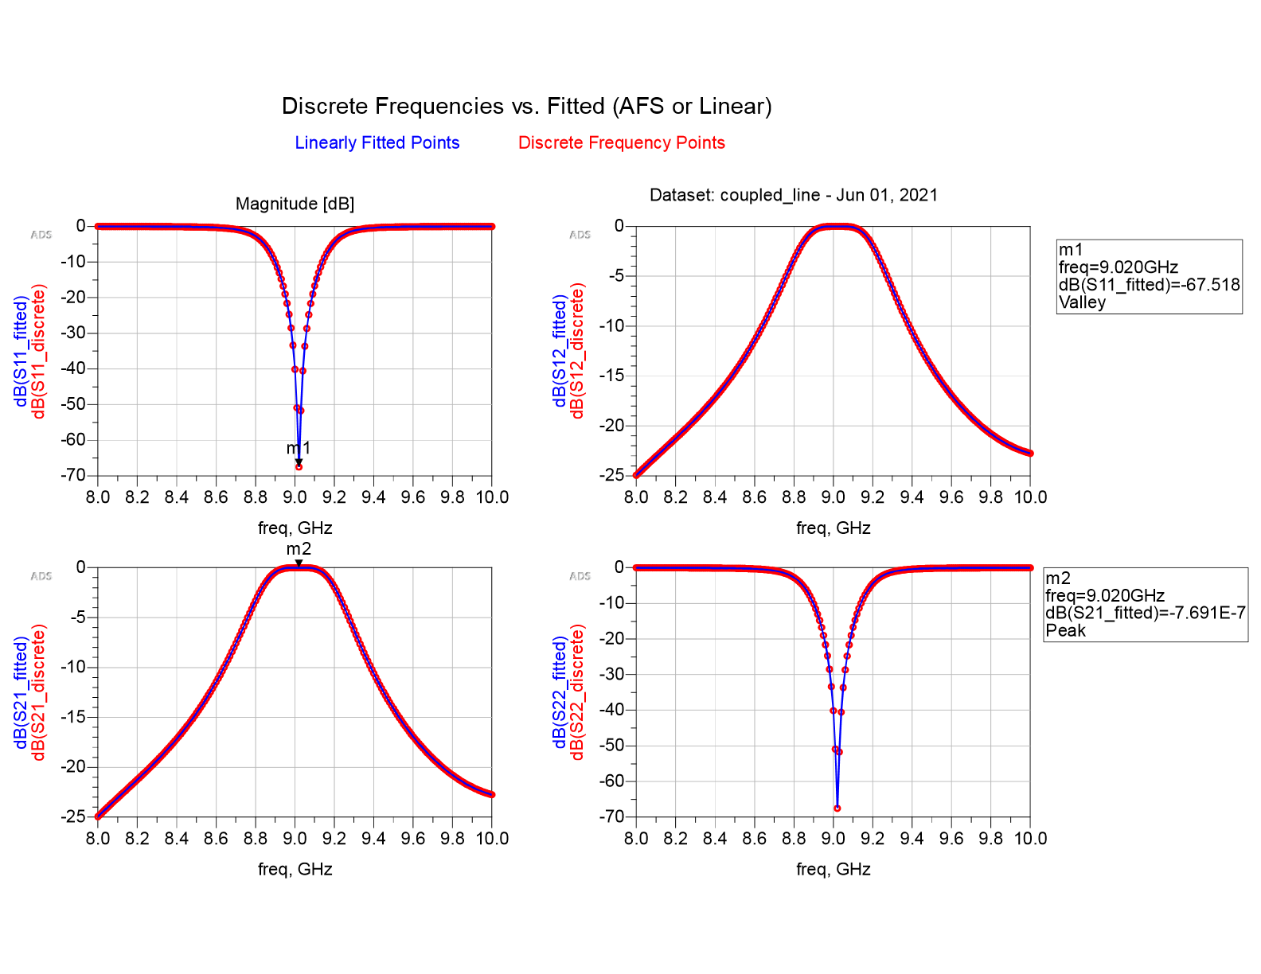
Simulated Results

Slide 14
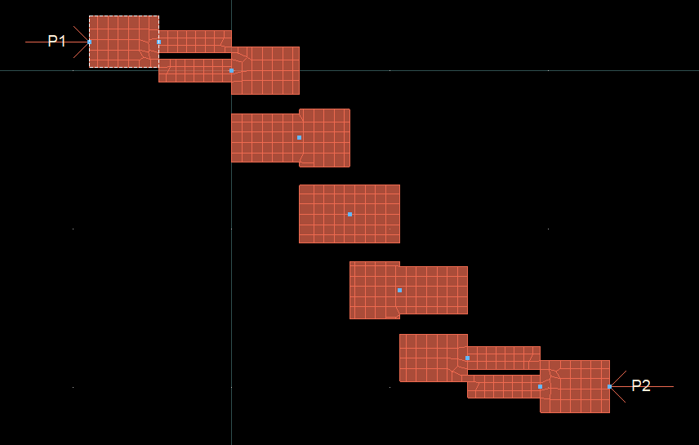
Filter Layout

Slide 15
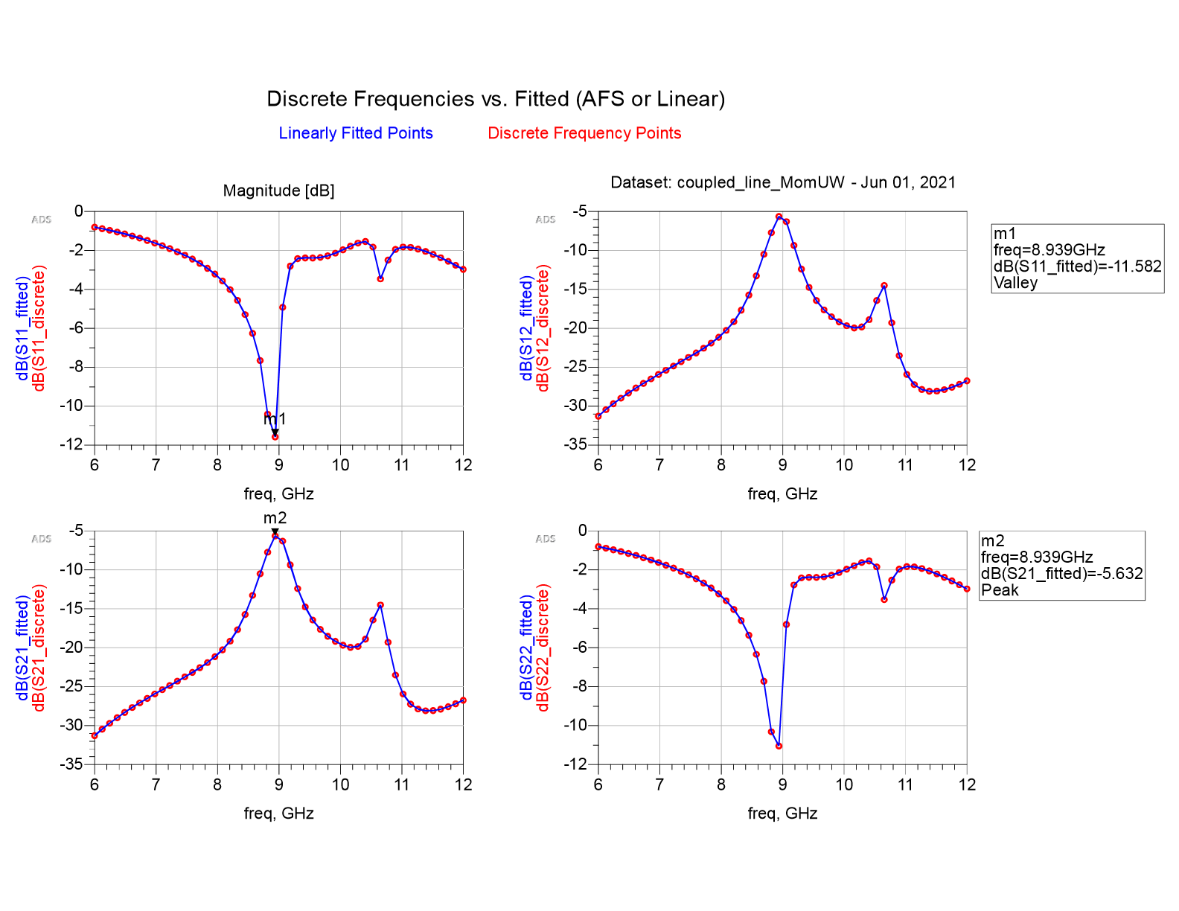
Layout Results

Slide 16
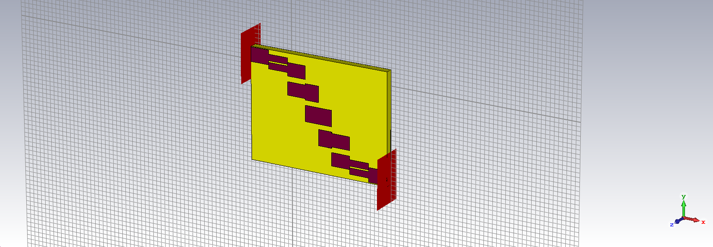
CST Design

Slide 17
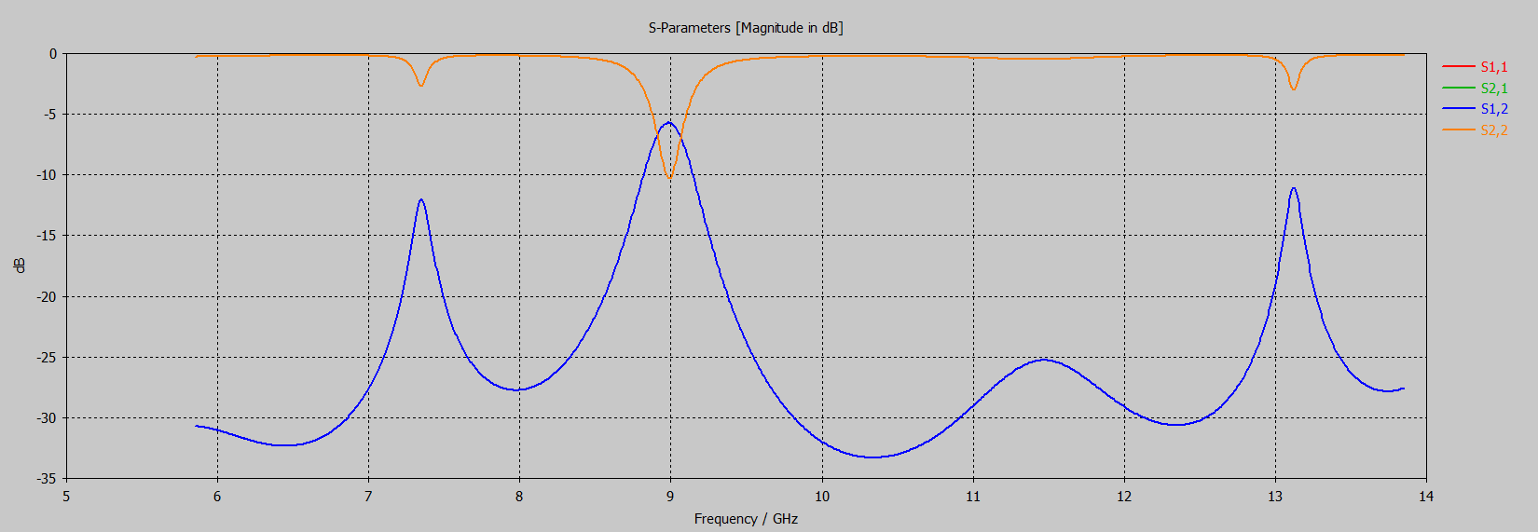
CST Design --> S parameter Output

Slide 18
Summary
Thus we have designed a 5th order Bandpass filter using coupled line sections for X-band applications centered at 9 GHz with 1GHz bandwidth.

Slide 19
Reference
Singh, P. K., Basu, S., & Wang, Y. H. (2009). Coupled line power divider with compact size and bandpass response. Electronics letters, 45(17), 892-894.
Karshenas, F., Mallahzadeh, A. R., & Rashed-Mohassel, J. (2009, February). Size reduction and harmonic suppression of parallel coupled-line bandpass filters using defected ground structure. In 2009 13th International Symposium on Antenna Technology and Applied Electromagnetics and the Canadian Radio Science Meeting (pp. 1-6). IEEE.
Garg, A., Pratap, B., & Gupta, D. (2016, February). Design of parallel coupled line band pass filter. In 2016 Second International Conference on Computational Intelligence & Communication Technology (CICT) (pp. 452-454). IEEE.
Lin, S. C. (2013). New microstrip cascaded-quadruplet bandpass filter based on connected couplings and short-ended parallel-coupled line. IEEE microwave and wireless components letters, 24(1), 2-4.

